Slide 1
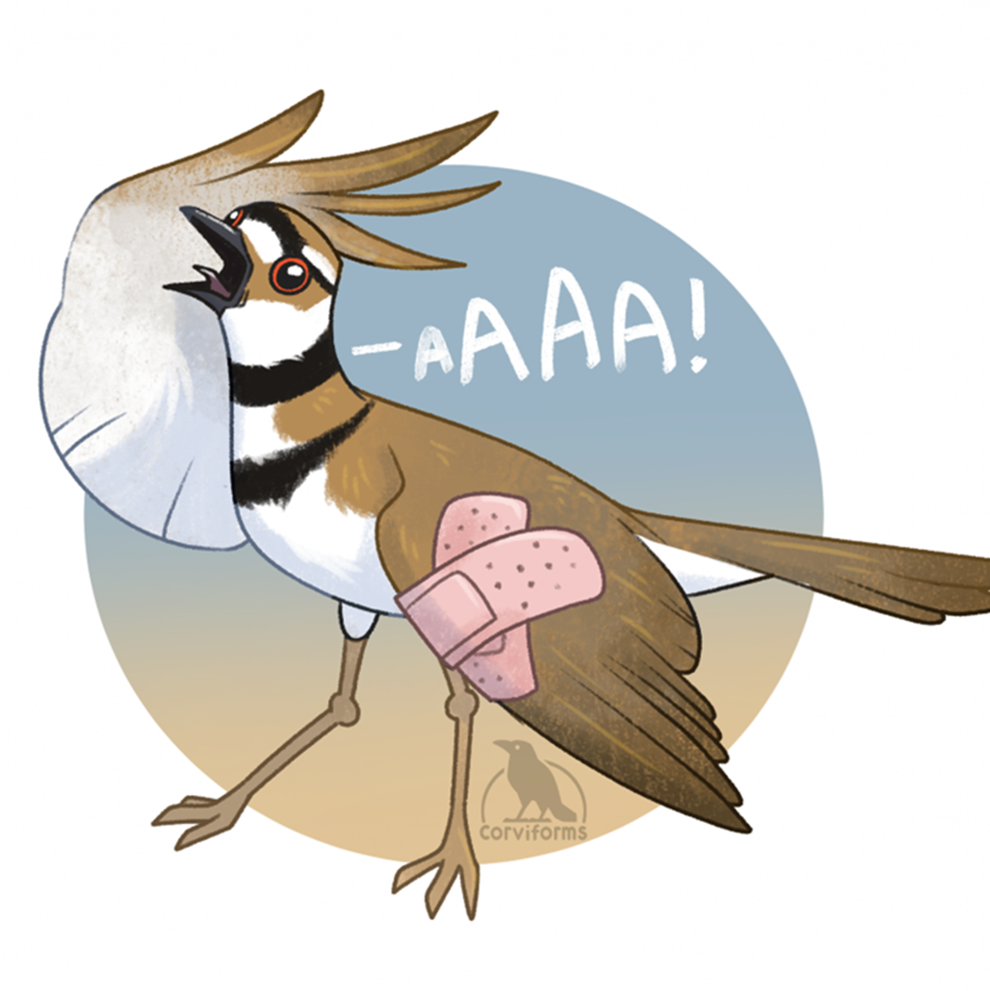
Nest defense behavior & Incubation Patterns in Killdeer
Brandy Williams
School of Biological sciences, EEB
Shizuka Lab

Slide 2
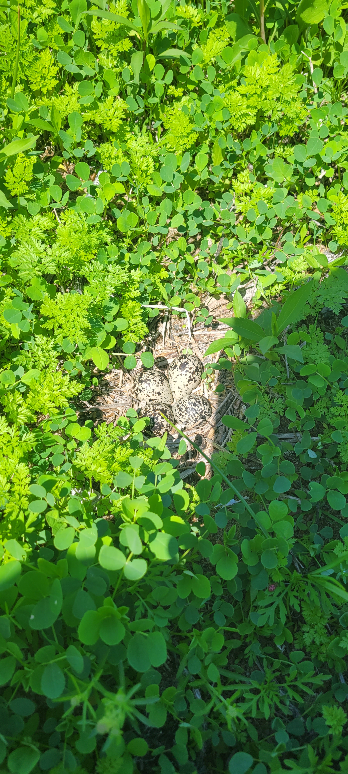
How does nest defense behavior affect offspring?
Nest is often left unshaded when defense behavior takes place
For how long?
Is there a potential risk to the eggs?
Last study looking at Killdeer incubation temperatures was done in 1989

Slide 3
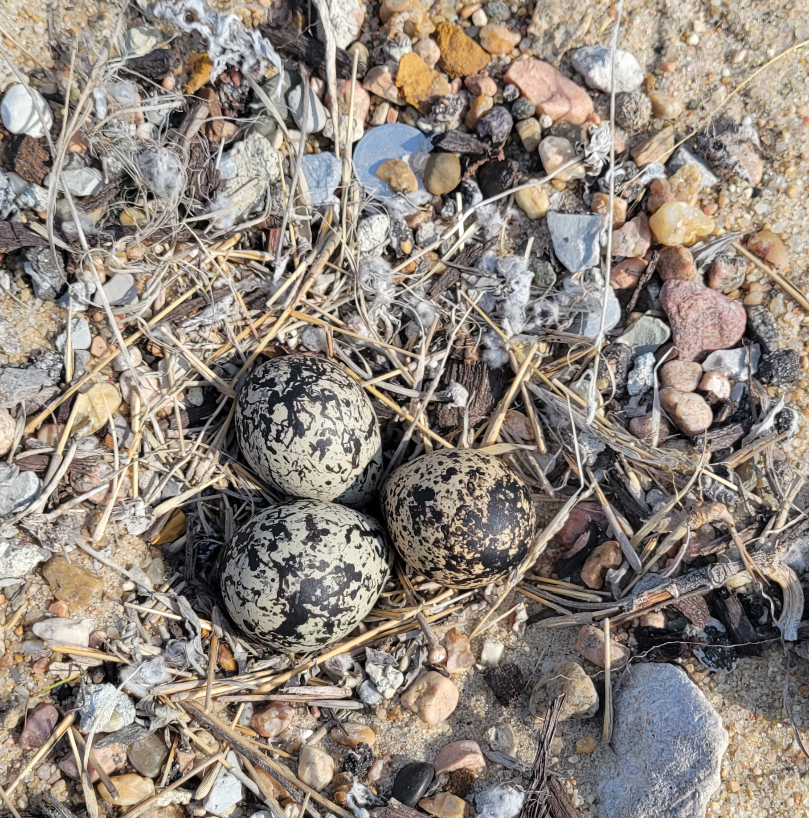
Collecting incubation temperature data in Killdeer
Proposed Methods:
Temperature data loggers
Behavioral observations
Air temperature data
Goal:
Use R to compare air temperatures and nest temperatures to better understand incubation patterns

Slide 4
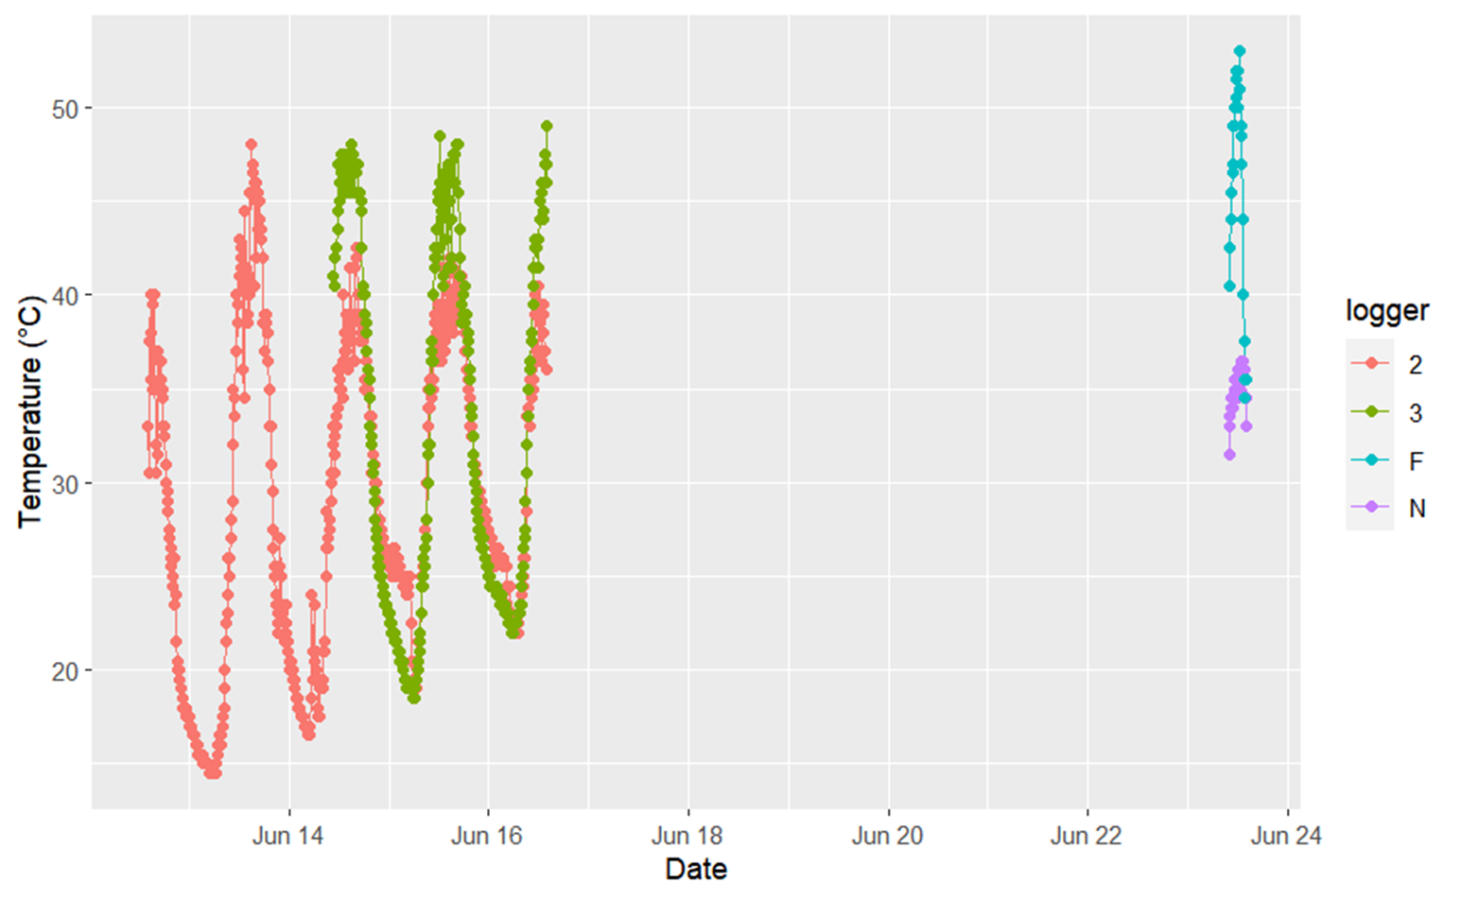
Results
4 loggers
3 in nests
1 outside of a nest
Captured egg laying in addition to incubation in 2 nests

Slide 5
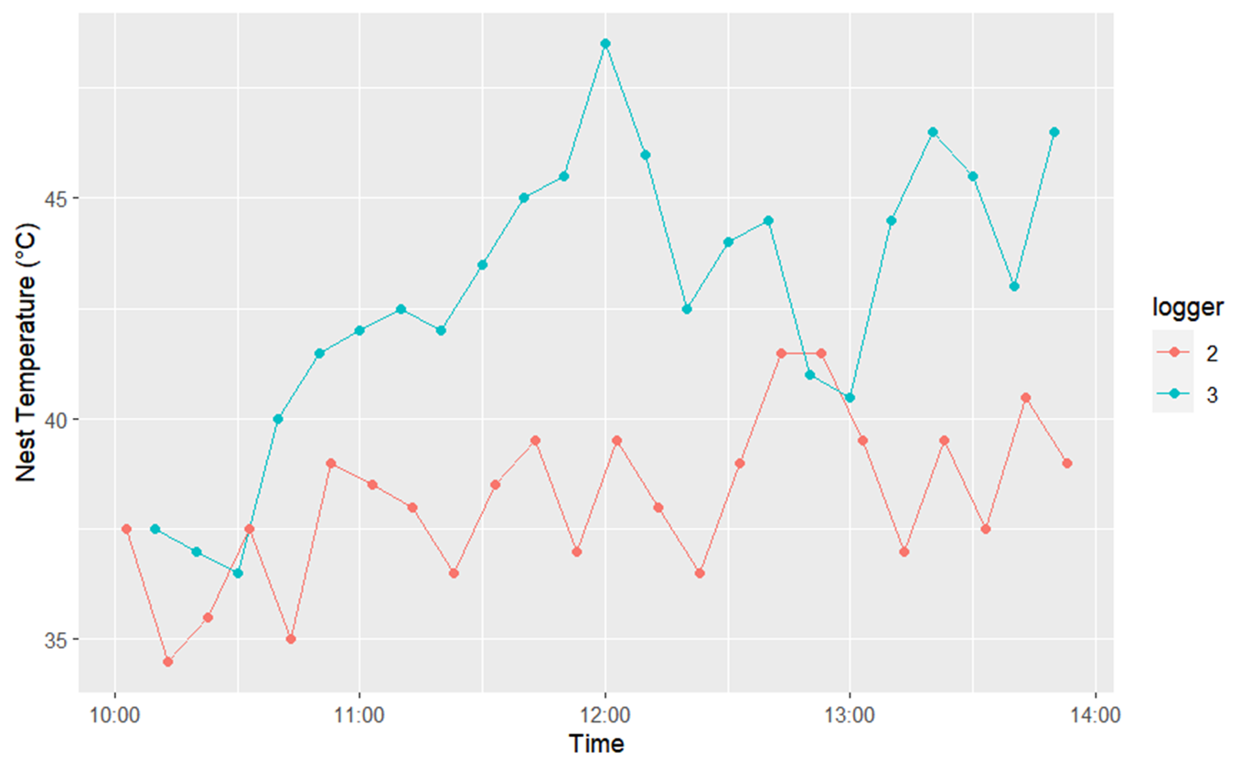
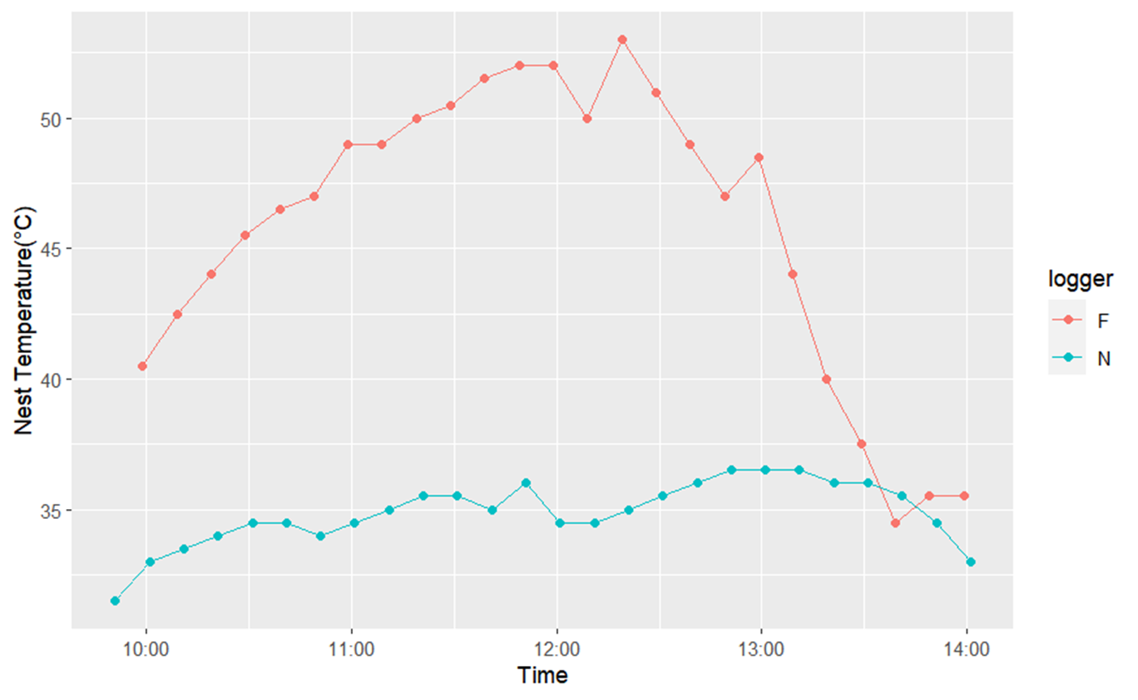
Results

Slide 6
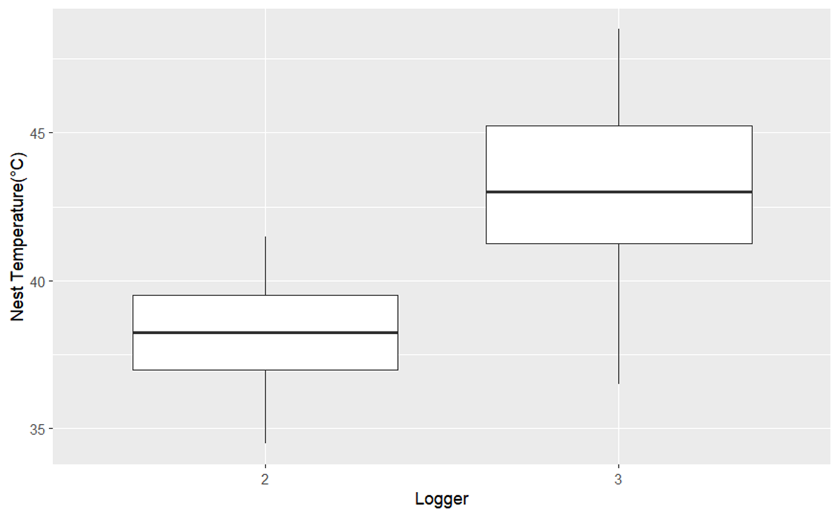
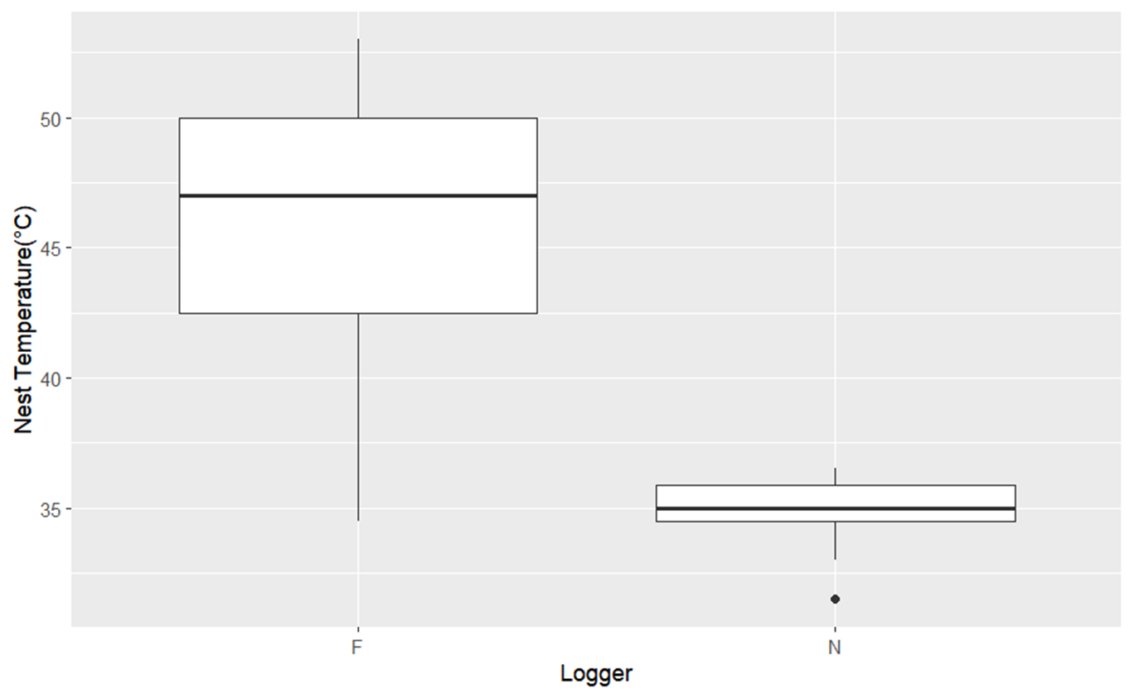
Results

Slide 7
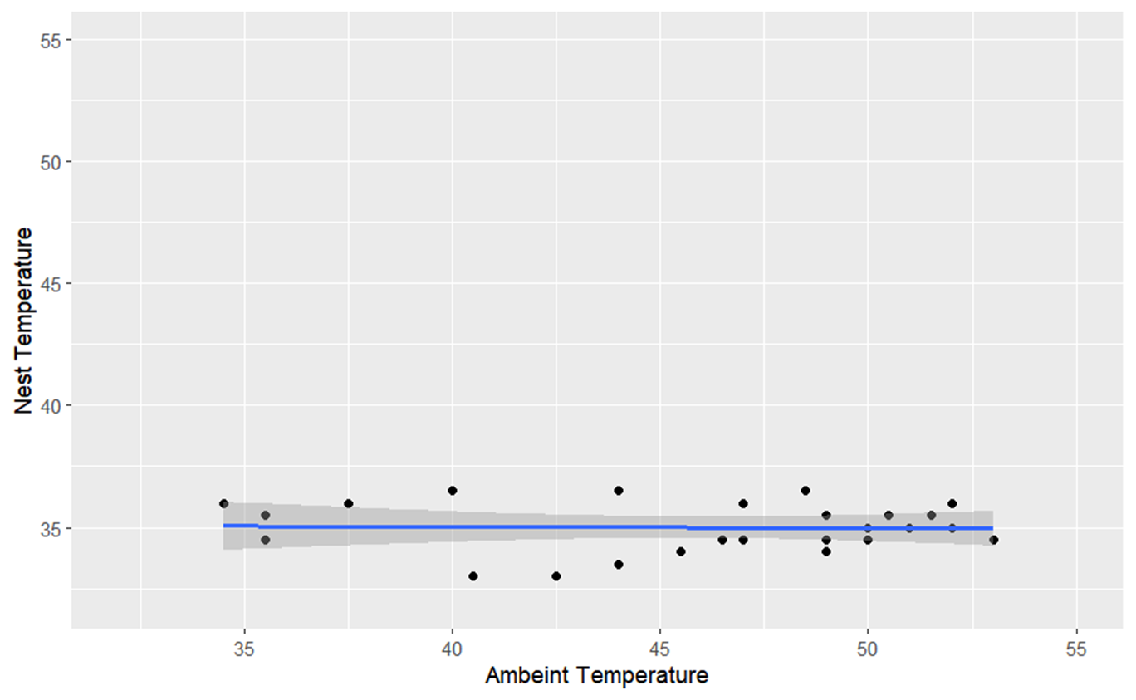
Results

